Slide 1
Battle of Neighborhood's
Discovering NYC’s Best Neighborhood for opening a Shopping Mall using Data Science.
By Jacob Theophilus Ayokanmi
Presentation made under IBM’s Professional Data Science Certification Coursera Capstone Project .

Slide 2
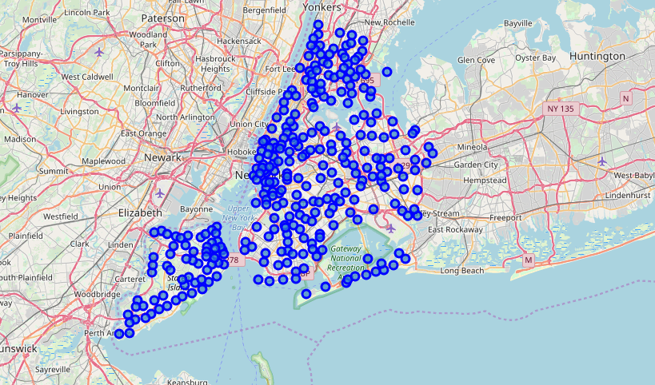
Business Problem
A Successful African Entrepreneur wants to expand his Business to NYC. He wants to open a Shopping Mall in USA but not sure in Locality he should open the Mall and be Successful.
Neighborhood of New York City

Slide 3
DATA
SOURCE
NYU Spatial Data Repository website: https://geo.nyu.edu/catalog/nyu_2451_34572
Foursquare API
For Venues in City and in Each locality in selected city.

Slide 4
METHODOLOGY
To suggest the best Location ,steps followed are -
The NYC Neighborhood Data was obtained from the USA website" https://geo.nyu.edu/catalog/nyu_2451_34572 , in Json format. The name of neighborhood, postcodes and borough was extracted from the JSon file and save as a data frame.
Geopy library was used to obtain the coordinates for each Borough in the data frame. Two columns were added to the data frame for the Longitude and Latitude.
The list of venues in NYC was obtained using Foursquare API and the weigh according to the Shopping Mall.
With the help of Unsupervised Machine Learning Algorithms (K means Algorithms), the neighborhoods were segmented into 3 clusters.
1
2
3
4

Slide 5
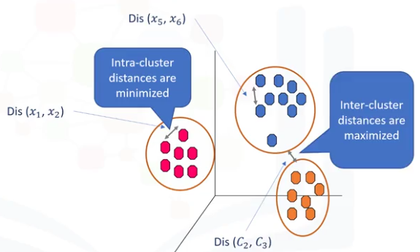
K- Means Clustering (Unsupervised Machine Learning Algorithm)
Unsupervised Learning
Supervise, means to observe, and direct the execution of a task, project, or activity. We do not supervise the model, but we let the model work on its own to discover information that may not be visible to the human eye. It means, the unsupervised algorithm trains on the dataset, and draws conclusions on unlabeled data.
What is a Cluster?
K-Means Clustering
1
A cluster is a group of data points or objects in a dataset that are similar to other objects in the group, and dissimilar to datapoints in other clusters.
2
K-Means is a type of partitioning clustering, that is, it divides the data into K non-overlapping subsets or clusters without any cluster internal structure or labels. This means, it's an unsupervised algorithm.

Slide 6

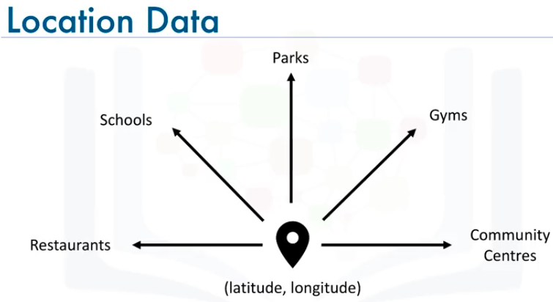
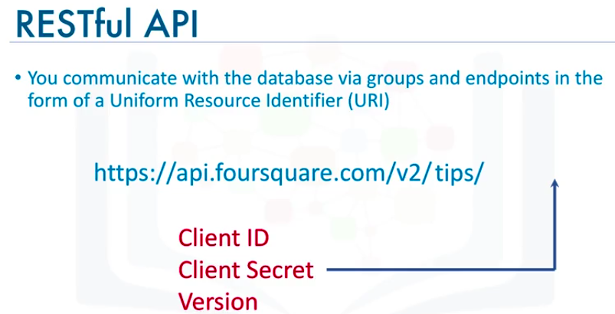
Location Data Provider – Foursquare
1
Location Data
Location data is data describing places and venues, such as their geographical location, their category, working hours, full address, and so on, such that for a given location given in the form of its geographical coordinates (or latitude and longitude values) one is able to determine what types of venues exist within a defined radius from that location.
2
Foursquare
Foursquare is a technologic company that built a massive dataset of accurate location data.
Foursquare powers location data for Apple, Uber, Snapchat, Twitter and many more.
Their API and location data is currently being used by over 100,000 developers.

Slide 7
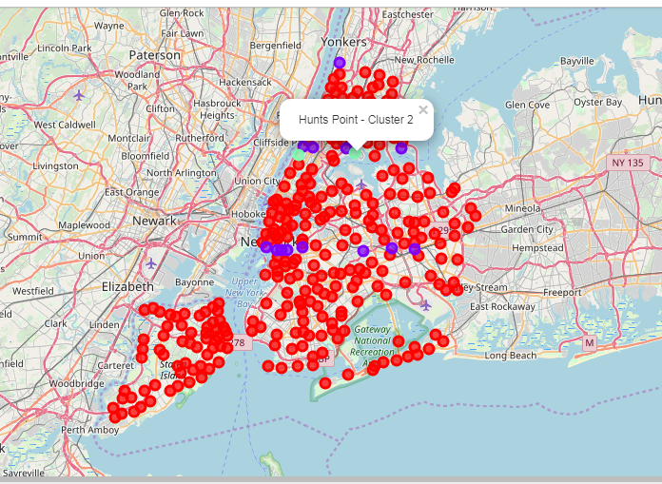
Results
Cluster 0: No single shopping mall in this neighborhood.
Cluster 1: High/Moderate number of shopping mall in this neighborhood.
Cluster 2: low number of shopping mall in this neighborhood.
Best Locality in New Jersey –
CLUSTER ONE (the red markers on the Map)

Slide 8
Discussions and Recommendations
1
In the Foursquare API, we have queried the Venues of a locality by specifying the LIMIT and Radius of our choice. We have chosen less LIMIT as the number of API calls that can be done using a free account in Four Square are less.
○ We can increase the limit for more accurate results.
○ We can increase the Radius for more venue results from each city
2
In the venue categories we are choosing only few out of 2000 that are available to give weights and identify the best cluster. Hence, assigning weights must be done relatively for each category and then considering more number of venue categories would actually yield a better output.

